Slide 1
PROJECTIONS

Slide 2
Transform 3D objects on to a 2D plane using projections 2 types of projections Perspective Parallel In parallel projection, coordinate positions are transformed to the view plane along parallel lines. In perspective projection, object position are transformed to the view plane along lines that converge to a point called projection reference point (center of projection)

Slide 3
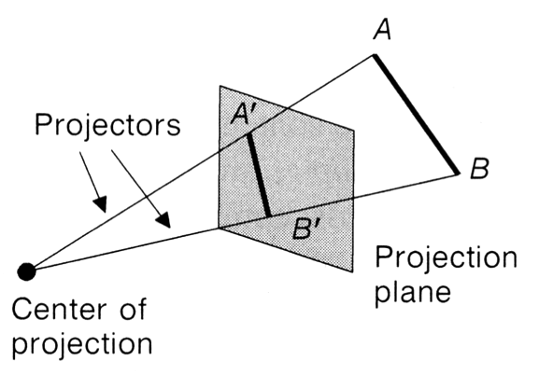
Perspective Projection

Slide 4
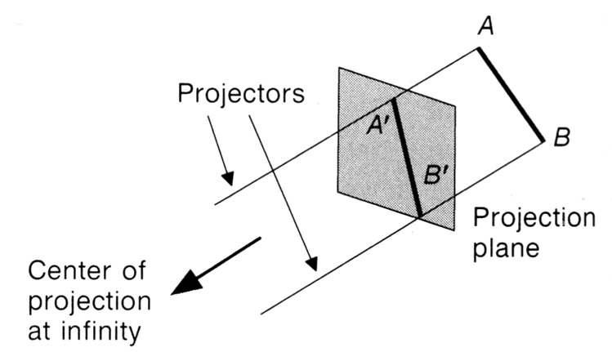
Parallel Projection

Slide 5
PROJECTIONS
PARALLEL
(parallel projectors)
PERSPECTIVE
(converging projectors)
One point
(one principal vanishing point)
Orthographic
(projectors perpendicular to view plane)
Oblique
(projectors not perpendicular to view plane)
Two point
(Two principal vanishing point)
Axonometric
(view plane not parallel to principal planes)
General
Multiview
(view plane parallel to principal planes)
Cavalier
Three point
(Three principal vanishing point)
Cabinet
Isometric
Dimetric
Trimetric

Slide 6
Perspective v Parallel
Perspective:
visual effect is similar to human visual system...
has 'perspective foreshortening'
size of object varies inversely with distance from the center of projection. Projection of a distant object are smaller than the projection of objects of the same size that are closer to the projection plane.
Parallel:
It preserves relative proportion of object.
less realistic view because of no foreshortening
however, parallel lines remain parallel.

Slide 7
Perspective Projections
Characteristics:
Center of Projection (CP) is a finite distance from object
Projectors are rays (i.e., non-parallel)
Vanishing points
Objects appear smaller as distance from CP (eye of observer) increases
Difficult to determine exact size and shape of object
Most realistic, difficult to execute

Slide 8
When a 3D object is projected onto view plane using perspective transformation equations, any set of parallel lines in the object that are not parallel to the projection plane, converge at a vanishing point.
There are an infinite number of vanishing points, depending on how many set of parallel lines there are in the scene.
If a set of lines are parallel to one of the three principle axis, the vanishing point is called an principal vanishing point.
There are at most 3 such points, corresponding to the number of axis cut by the projection plane.

Slide 9
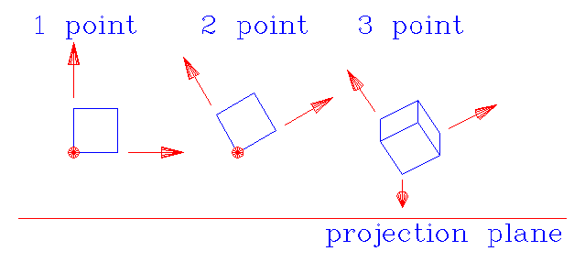
Classes of Perspective Projection
One-Point Perspective
Two-Point Perspective
Three-Point Perspective

Slide 10
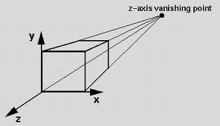
One-Point Perspective

Slide 11
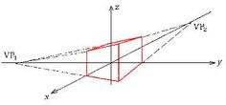
Two-point perspective projection:
This is often used in architectural, engineering and industrial design drawings.

Slide 12
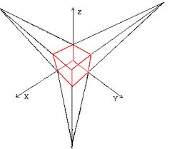
Three-point perspective projection
Three-point perspective projection is used less frequently as it adds little extra realism to that offered by two-point perspective projection

Slide 13
Parallel Projections
We can define a parallel projection with a projection vector that defines the direction for the projection lines.
2 types:
Orthographic : when the projection is perpendicular to the view plane. In short,
direction of projection = normal to the projection plane.
the projection is perpendicular to the view plane.
Oblique : when the projection is not perpendicular to the view plane. In short,
direction of projection ≠ normal to the projection plane.
Not perpendicular.

Slide 14
Orthographic projection
Oblique projection
when the projection is perpendicular to the view plane
when the projection is not perpendicular to the view plane

Slide 15
Orthographic (or orthogonal) projections:
Front, side and rear orthographic projection of an object are called elevations and the top orthographic projection is called plan view.
all have projection plane perpendicular to a principle axes.
Here length and angles are accurately depicted and measured from the drawing, so engineering and architectural drawings commonly employee this.
However, As only one face of an object is shown, it can be hard to create a mental image of the object, even when several views are available.

Slide 16
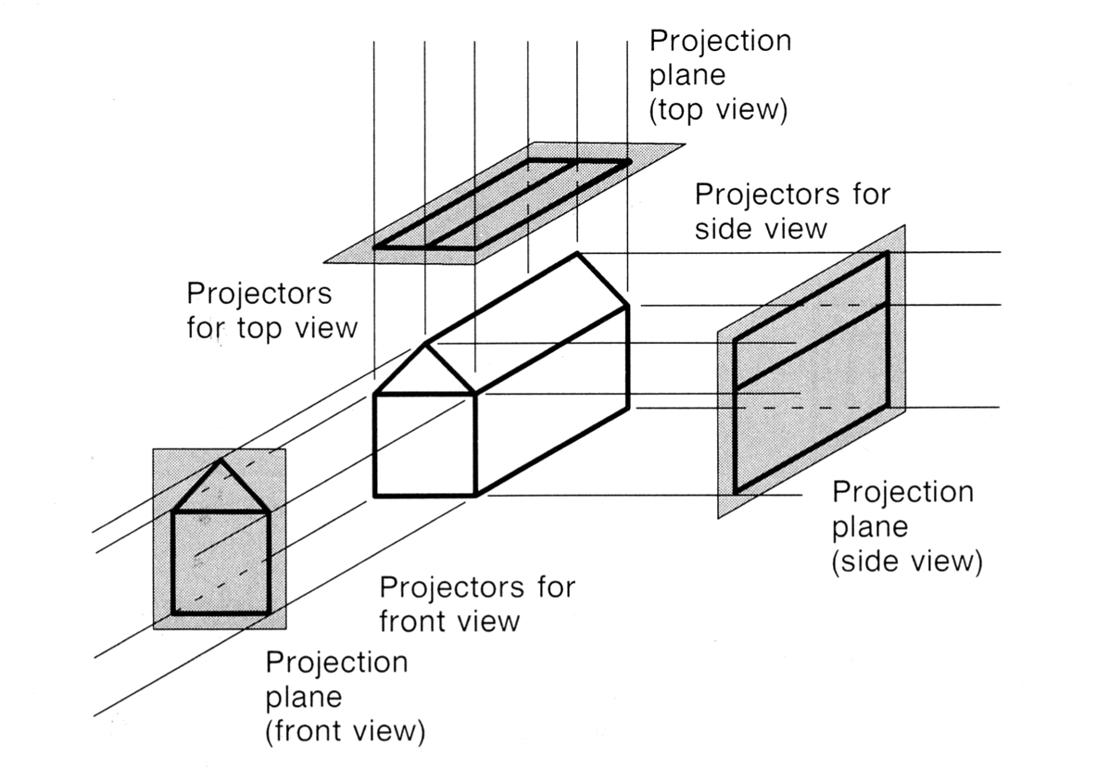
Orthogonal projections:

Slide 17
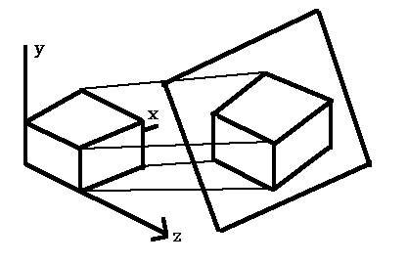
Axonometric orthographic projections
Orthographic projections that show more than one face of an object are called axonometric orthographic projections.
The most common axonometric projection is an isometric projection where the projection plane intersects each coordinate axis in the model coordinate system at an equal distance.

Slide 18
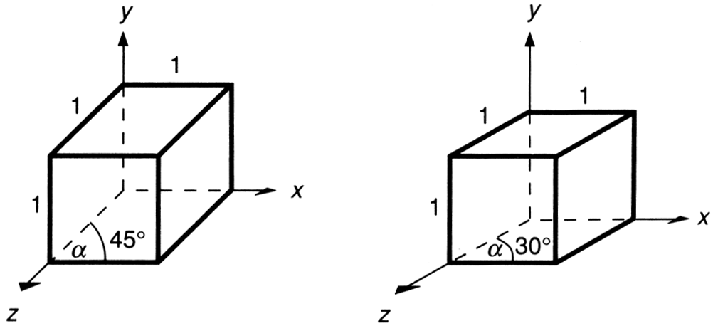
2 common oblique parallel projections:
Cavalier and Cabinet
Cavalier projection:
All lines perpendicular to the projection plane are projected with no change in length.

Slide 19
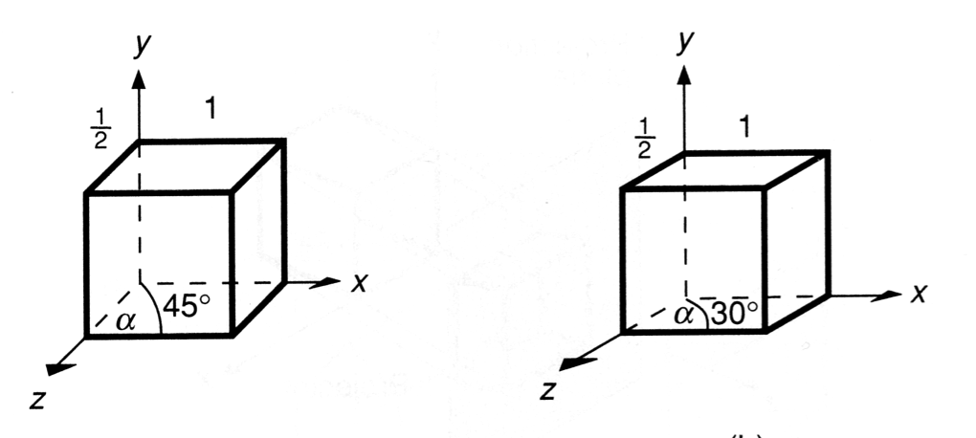
Cabinet projection:
Lines which are perpendicular to the projection plane (viewing surface) are projected at 1 / 2 the length .
This results in foreshortening of the z axis, and provides a more “realistic” view.

